Slide 1
Fuzzy Inference (Expert) System
CSE 4109: Artificial Intelligence

Slide 2
Introduction
A Fuzzy Inference System (FIS) is a way of mapping an input space to an output space using fuzzy logic
FIS uses a collection of fuzzy membership functions and rules, instead of Boolean logic, to reason about data.
The rules in FIS (sometimes may be called as fuzzy expert system) are fuzzy production rules of the form:
  if p then q, where p and q are fuzzy statements.
For example, in a fuzzy rule
  if x is low and y is high then z is medium.
  Here x is low; y is high; z is medium are fuzzy statements; x and y are input variables; z is an output variable, low, high, and medium are fuzzy sets.

Slide 3
Cont…
The antecedent describes to what degree the rule applies, while the conclusion assigns a fuzzy function to each of one or more output variables.
Most tools for working with fuzzy expert systems allow more than one conclusion per rule.
The set of rules in a fuzzy expert system is known as knowledge base.
The functional operations in fuzzy expert system proceed in the following steps.
  Fuzzification
  Fuzzy Inferencing (apply implication method)
  Aggregation of all outputs
  Defuzzification

Slide 4
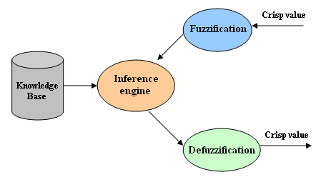
Structure of a Fuzzy Expert System

Slide 5
Fuzzification
In the process of fuzzification, membership functions defined on input variables are applied to their actual values so that the degree of truth for each rule premise can be determined.
Fuzzy statements in the antecedent are resolved to a degree of membership between 0 and 1.
  If there is only one part to the antecedent, then this is the degree of support for the rule.
  If there are multiple parts to the antecedent, apply fuzzy logic operators and resolve the antecedent to a single number between 0 and 1.
Antecedent may be joined by OR; AND operators.
  For OR -- max
  For AND -- min

Slide 6
Fuzzy Inferencing
In the process of inference
  Truth value for the premise of each rule is computed and applied to the conclusion part of each rule.
  This results in one fuzzy set to be assigned to each output variable for each rule.
The use of degree of support for the entire rule is to shape the output fuzzy set.
The consequent of a fuzzy rule assigns an entire fuzzy set to the output.
If the antecedent is only partially true, (i.e., is assigned a value less than 1), then the output fuzzy set is truncated according to the implication method.

Slide 7
Cont...
If the consequent of a rule has multiple parts, then all consequents are affected equally by the result of the antecedent.
The consequent specifies a fuzzy set to be assigned to the output.
The implication function then modifies that fuzzy set to the degree specified by the antecedent.
The following functions are used in inference rules.
min or prod are commonly used as inference rules.
  min: truncates the consequent's membership function
  prod: scales it.

Slide 8
Aggregation of all outputs
It is the process where the outputs of each rule are combined into a single fuzzy set.
The input of the aggregation process is the list of truncated output functions returned by the implication process for each rule.
The output of the aggregation process is one fuzzy set for each output variable.
  Here, all fuzzy sets assigned to each output variable are combined together to form a single fuzzy set for each output variable using a fuzzy aggregation operator.
Some of the most commonly used aggregation operators are
  the maximum : point-wise maximum over all of the fuzzy sets
  the sum : (point-wise sum over all of the fuzzy
  the probabilistic sum.

Slide 9
Defuzzification
In Defuzzificztion, the fuzzy output set is converted to a crisp number.
Some commonly used techniques are the centroid and maximum methods.
  In the centroid method, the crisp value of the output variable is computed by finding the variable value of the centre of gravity of the membership function for the fuzzy value.
  In the maximum method, one of the variable values at which the fuzzy set has its maximum truth value is chosen as the crisp value for the output variable.
Some other methods for defuzzification are:
  bisector, middle of maximum (the average of the maximum value of the output set), largest of maximum, and smallest of maximum, etc.

Slide 10
Generic Method
Main steps are
  Evaluate the antecedent for each rule
  Obtain each rule's conclusion
  Aggregate conclusions
  Defuzzification
We will explain these steps using an example of Tipping Problem
Two inputs : Quality of food and Service at a restaurant rated at scale from 0-10
One output: Amount of tip to be given
Tip should reflect the quality of the food and service.
The tip might be in the range 5-25% of total bill paid.

Slide 11
Rules for Tipping
Let us consider the following three rules
  If service is poor or food is bad, then tip is cheap
  If service is good, then tip is average
  If service is excellent or food is delicious, then tip is generous
Input variables
  Service : represented by poor, good, excellent
  Food : represented by bad, delicious
Output Variable:
  Tip : represented by cheap, average, generous

Slide 12
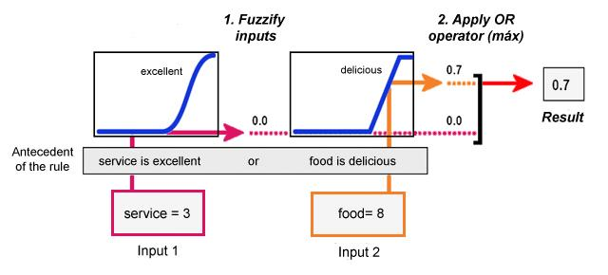
Antecedent for each rule

Slide 13
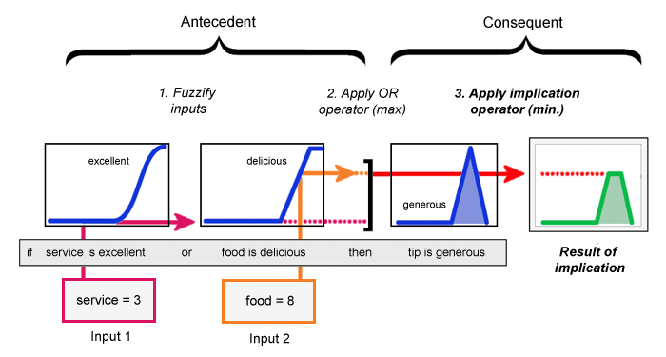
Rule's Conclusion

Slide 14
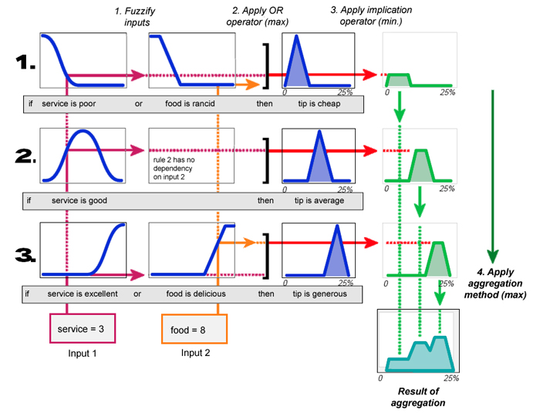
Aggregate Conclusions

Slide 15
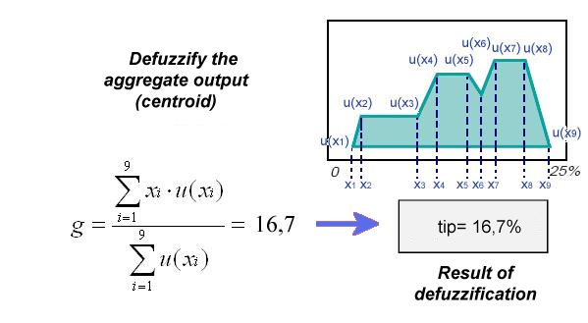
Defuzzification

Slide 16
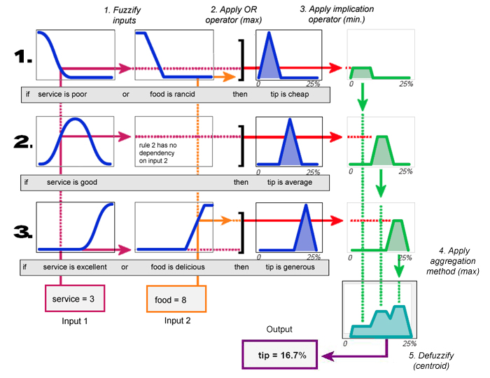
All Steps Together looks like

Slide 17
MatLab
Fuzzy Toolkit

Slide 18
Introduction
MATLAB fuzzy logic toolbox provides facility for the development of fuzzy-logic systems using
  graphical user interface (GUI) tools
  command line functionality
There are five primary GUI tools
  Fuzzy Inference System (FIS) Editor
  Membership Function Editor
  Rule Editor
  Rule Viewer
  Surface Viewer

Slide 19
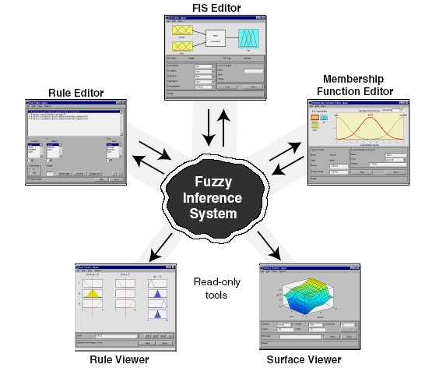
GUI Tools

Slide 20
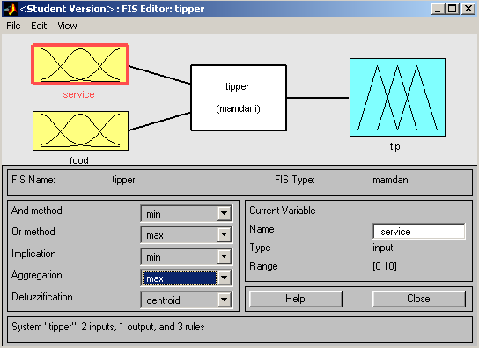
Fuzzy Inference System (FIS) Editor

Slide 21
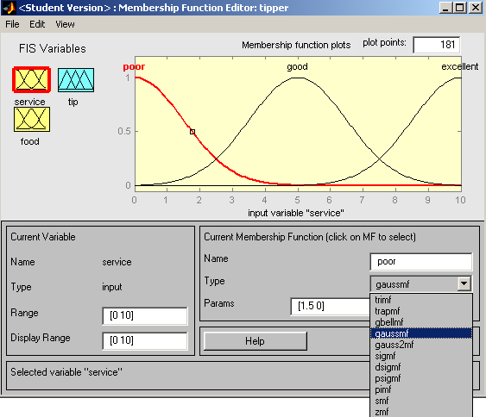
Membership Function Editor
Select & edit attributes of membership function
Display & edit values of current variable
Name & edit parameters of membership function

Slide 22
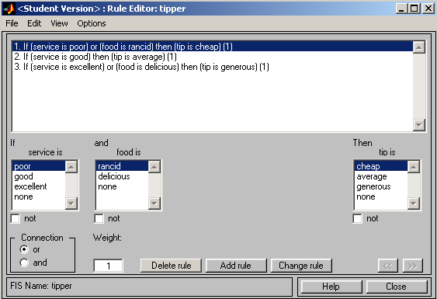
Rule Editor
Rules – automatically updated
Create and edit rules

Slide 23
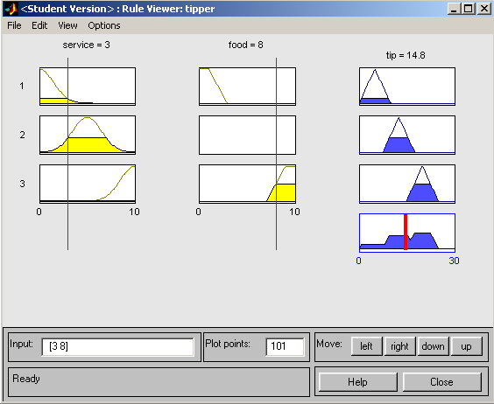
Rule Viewer
Shows how input variable is used in rules
Shows how output variable is used in rules; shows output of fuzzy system

Slide 24
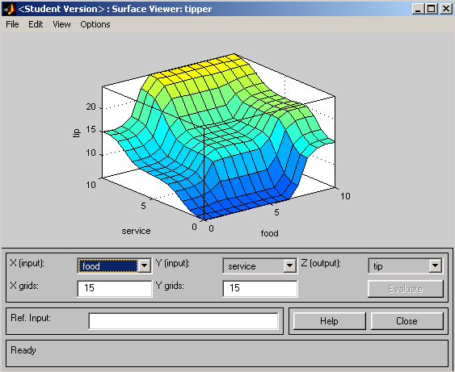
Surface Viewer
Shows output surface for any system output versus any one (or two) inputs
Specify input and output variables

